Slide 1
Collecting and analysing data before starting a business
Case study 2

Slide 2
Table of content
Introduction
Business needs
Location Analysis
Competitor Analysis
Insight and Solution

Slide 3
Introduction
Before starting a business a person or a organisation needs to research his competitors, find the USPs and find the target group to properly assess their business model. Here we are going to perform that step by step.

Slide 4
Business Needs
A man wants to open a Wada pav shop near Shivaji Nagar, Pune.
He has got a location where he has got 4 more Wada pav shop
He needs to figure out the strategy to take over the clients.
What will be the price of each Wada pav.
How will he differentiate from other competitors.

Slide 5
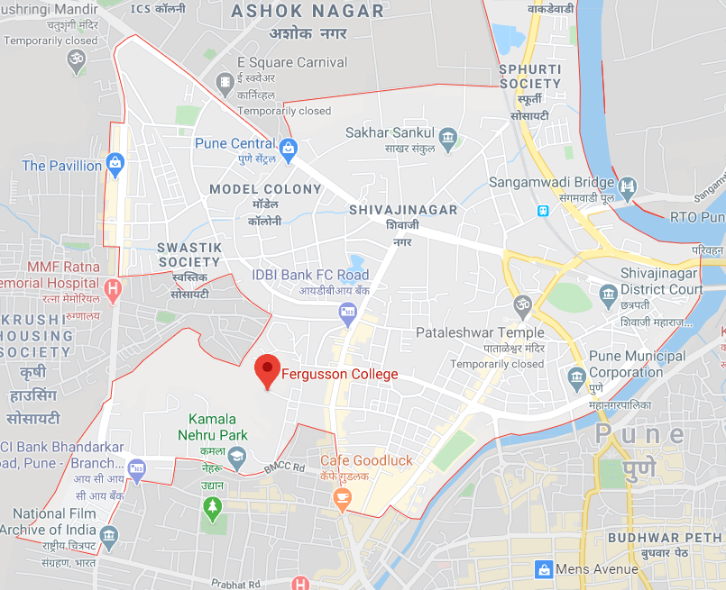
Location Analysis
In Shivaji Nagar there are many colleges, institutions and offices.
Print flyers and distribute them by hand.
Make special combos so that groups can buy at a cheaper price
50% discount on 1st purchase through online bookings so that people can get familiarized with the services.

Slide 6
Competitor Analysis
Wada Pav shops(Competitors)
Chotu Kolhapuri, Wada pav Store | Garden Vada pav | Sir Misal
Cheese Vada Pav-25 | Garden Vada Pav (Pillow pav, stuffed wit golden-fried spiced batata)-19 | Sir misal-75
Myonees vada pav-20 | 2 Garden Vada Pav-38 | corn misal-75
Vada pav-10 |  | kolhapur misal - 75
Corn Patties-18 |  | Bhakari misal - 75
Bhel-20 |  | Cheese Misal 95
Chees corn Patties-27 |  | Dahi Misal -95
Myonees Corn Patties-20 |  | Misal meal - 115
Cheese myonees corn patties-30 |  | Kokam Sarbat-20
Pharali Pattice-10 |  | taak-25
Chhotu sodawala (cola,orange,lemon,jeera masala, pineaplle, green apple, fruit bear)-15 |  | lassi-35
chotu ki chai-10 |  | Mango Lassi-45
Peru kulpi-15 |  | solkadhi-30
strawberry kulpi-15 |  | Guava Sarbat-20
Chotu malai kulpi-12 |  | Laddu-10
Chotu mango kulpi-15 |  | Gulkand burfi 20
 |  | Karadant 25
 |  | Gajar halwa35

Slide 7
Insight and Solution
From the analysis it is clear that what should be the competitive price range for our Wada pav shop.
The highlighted items and prices should be considered while making the menu.
COMBOS are not offered in the competitor restaurants so for better business, COMBOS like
Any type of VADA PAV with Beverages
Any type of Patties with Beverages
Any type of VADA PAV with sweets
Any type of Patties with sweets
Maha Combo with VADA, Pattie, Beverages, sweet
Combo offers should be offered at a lower price than the individual price, so that customers can try out different items. From that popularity can be identified
As there are many offices and institutes near by so a themed café with proper ambience can attract a lot of office goers and students.

Slide 8
Thank you !

